Slide 1
JAVA Programming

Slide 2
TOPICs to be discussed
Introduction to Java Collection Framework
Collection Framework Hierarchy
Collection Interface
Iterator and Iterable Interface
List Interface
Different List Traversal techniques
ArrayList
LinkedList
Vector
Stack

Slide 3

Let’s START …!!!

Slide 4
Collection and Framework
A Collection represents a single unit of objects, i.e., a group.
The Collection in Java is a framework that provides an architecture to store and manipulate the group of objects.
Java Collections can achieve all the operations that you perform on a data such as searching, sorting, insertion, manipulation, and deletion.
What is a Framework in Java?
A Framework provides a ready-made structure of classes and interfaces for building software applications efficiently.

Slide 5
Java Collection Framework
The Collection framework represents a unified architecture for storing and manipulating a group of objects.
It enhances code efficiency and readability by offering various data structures, including arrays, linked lists, trees, and hash tables, tailored to different programming needs.
Why Collection Framework?
Before JDK 1.2, Java’s approach to collections relied on Arrays, Vectors, and Hash tables.
Each type of collection had its own set of methods, syntax, and constructors, without any standardization.
Developers had to remember different methods and syntax for each collection, making the code harder to work with.
This lack of cohesion emphasized the need for a unified Collection Framework to simplify and standardize collection operations.

Slide 6
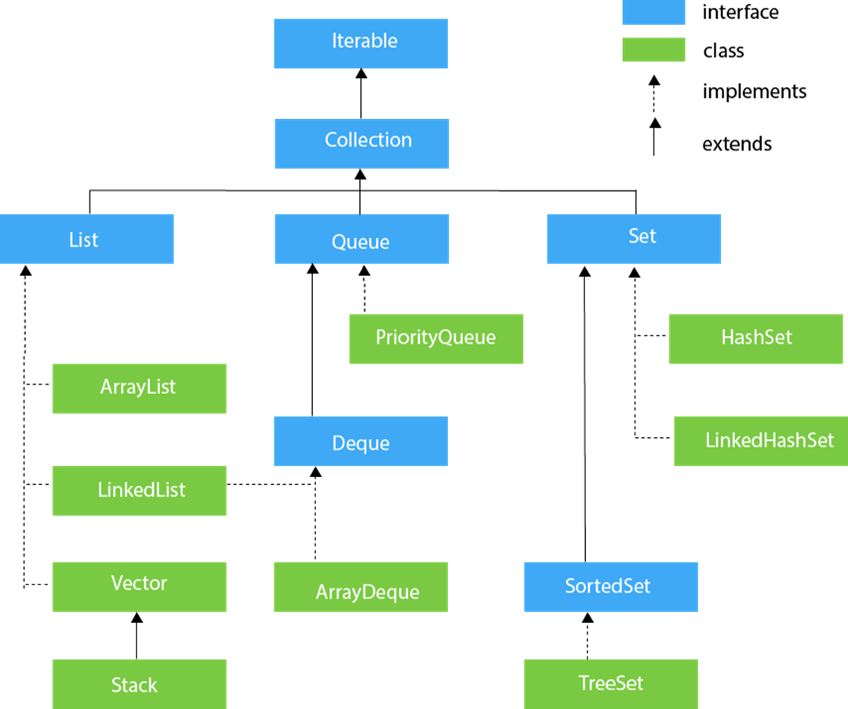
Collection Framework Hierarchy

Slide 7
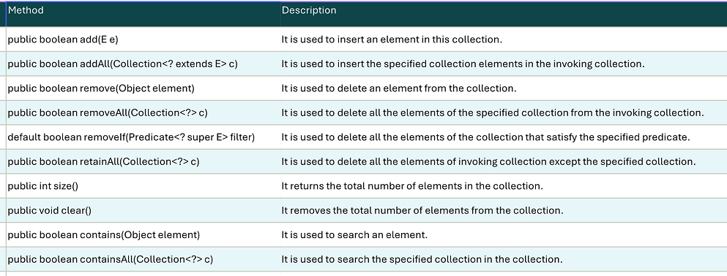
Collection Interface
The Collection interface is the root interface of the collection framework hierarchy.
Java does not provide direct implementations of the Collection interface but provides implementations of its sub-interfaces like List, Set, and Queue.

Slide 8
Iterable and Iterator Interface
The Iterable and Iterator interfaces are part of the Java Collections Framework, providing a way to traverse or iterate over elements in a collection.
While they are related, they have distinct purposes and roles.
Iterable Interface
The Iterable interface is present in java.lang package and is the root interface for all collection classes. It allows an object to be the target of the for-each loop.
Key Points:
It has only one method: iterator(), which returns an Iterator.
Implementing Iterable<T> allows the collection to be iterated using an enhanced for loop.
Common collections like ArrayList, HashSet, and LinkedList implement Iterable.

Slide 9
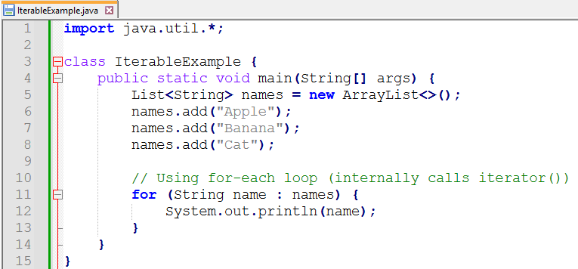

Iterable (Example)

Slide 10
Iterable and Iterator Interface
Iterator Interface
The Iterator interface is present in Java.util package, provides methods to iterate over a collection.
Key Methods:
hasNext(): Returns true if more elements exist.
next(): Returns the next element.
remove(): Removes the last element returned by next().

Slide 11
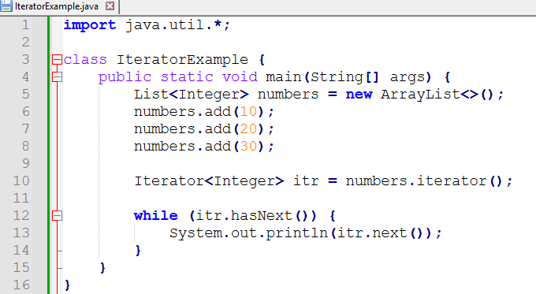

Iterator (Example)

Slide 12
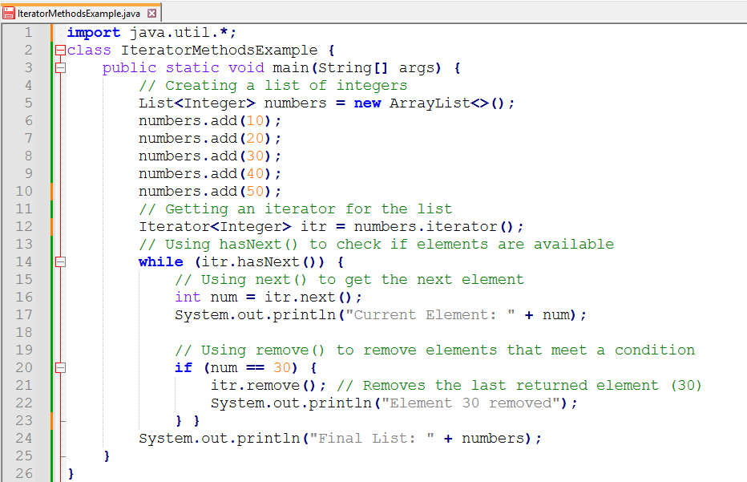
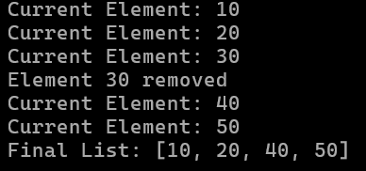
Iterator (Example 2)

Slide 13
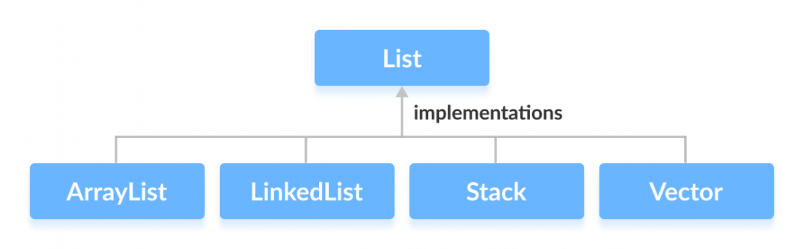
List Interface
In Java, the List interface is an ordered collection that allows us to store and access elements sequentially.
It extends the Collection interface.
Since List is an interface, we cannot create objects from it.
To use the functionalities of the List interface, we can use these classes:
ArrayList
LinkedList
Vector
Stack
List implementation:
List<String> list1 = new ArrayList<>(); //Using ArrayList
List<String> list2 = new LinkedList<>(); //Using LinkedList

Slide 14
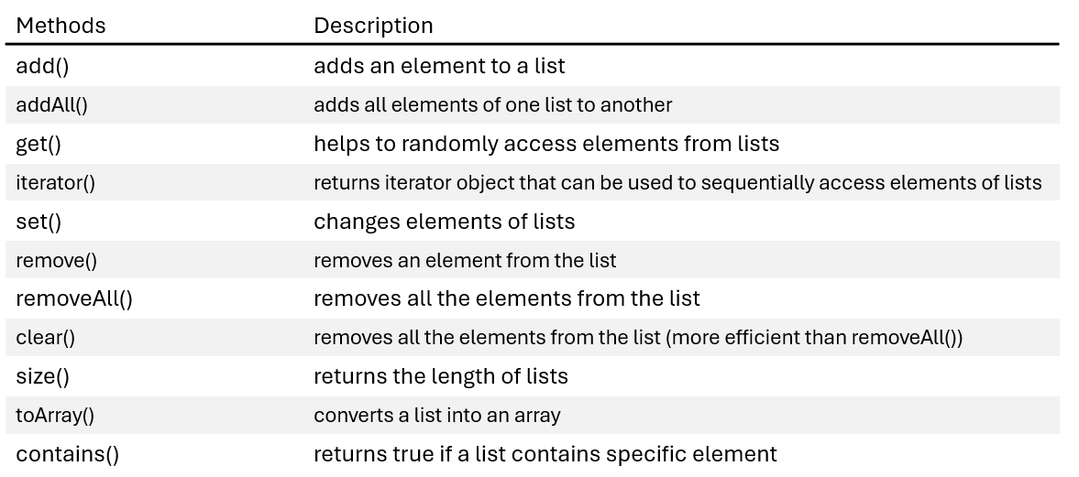
Methods of List Interface

Slide 15
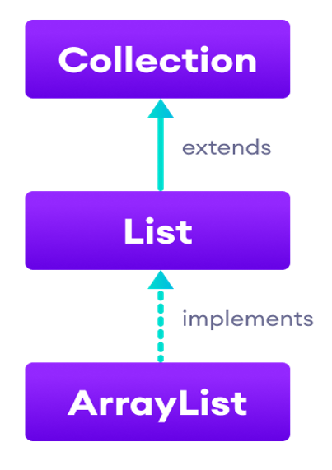
ArrayList
In Java, we need to declare the size of an array before we can use it. Once the size of an array is declared, it’s hard to change it.
To handle this issue, we can use the ArrayList class. It allows us to create resizable arrays.
Unlike arrays, arraylists can automatically adjust their capacity when we add or remove elements from them. Hence, arraylists are also known as dynamic arrays.
Properties:
1. Fast access to elements
2. Slow insertion, deletion of elements
3. Best suited for frequent access, less modification
scenarios

Slide 16
ArrayList (Example)
import java.util.List;
import java.util.ArrayList;
class ArrayListDemo {
public static void main(String[] args) {
//Creating an ArrayList of Strings
ArrayList<String> ltrs = new ArrayList<>();
//Adding elements
ltrs.add("A"); ltrs.add("B");
List<String> list = new ArrayList<>();
list.add("C"); list.add("D");
ltrs.addAll(2, list);
System.out.println("letters: "+ ltrs);
//Access elements
System.out.println("Element-2: "+ ltrs.get(1));
//Changing element
ltrs.set(2, "X");
System.out.println("letters: "+ ltrs);
//Removing element
ltrs.remove(2);
System.out.println("letters: "+ ltrs);
}
}
Output:
letters: [A, B, C, D]
Element-2: B
letters: [A, B, X, D]
letters: [A, B, D]

Slide 17
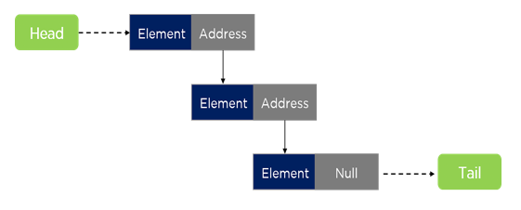
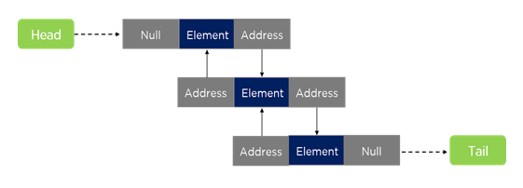
LinkedList
LinkedList is a doubly-linked list implementation of the List and the Deque interface.
It allows duplicates and maintains insertion order.
Properties:
1. Slower access to elements
2. Fast insertion, deletion of elements
3. Best suited for frequent
modification (insertion/deletion)
scenarios

Slide 18
LinkedList (Example)
import java.util.List;
import java.util.LinkedList;
class LinkedListDemo {
public static void main(String[] args) {
//Creating an LinkedList of Strings
LinkedList<String> ltrs = new LinkedList<>();
//Adding elements
ltrs.add("A"); ltrs.add("B");
List<String> list = new LinkedList<>();
list.add("C"); list.add("D");
ltrs.addAll(2, list);
System.out.println("letters: "+ ltrs);
//Access elements
System.out.println("Element-2: "+ ltrs.get(1));
//Changing element
ltrs.set(2, "X");
System.out.println("letters: "+ ltrs);
//Removing element
ltrs.remove(2);
System.out.println("letters: "+ ltrs);
}
}
Output:
letters: [A, B, C, D]
Element-2: B
letters: [A, B, X, D]
letters: [A, B, D]

Slide 19
Vector
import java.util.Vector;
class VectorDemo {
public static void main(String[] args) {
//Creating a Vector of Strings
Vector<String> ltrs = new Vector<>();
//Adding and Accessing elements
ltrs.add("A"); ltrs.add("B"); ltrs.add("C");
System.out.println("letters: "+ ltrs);
System.out.println("Element-2: "+ ltrs.get(1));
ltrs.set(2, "X"); //Changing element
System.out.println("letters: "+ ltrs);
ltrs.remove(2); //Removing element
System.out.println("letters: "+ ltrs);
//Capacity of the vector
System.out.println("Capacity: " + ltrs.capacity());
}
}
A Vector is a dynamic array that can grow or shrink in size as needed.
It is part of java.util and implements the List interface, making it compatible with most collection operations.
Unlike an ArrayList, Vector is synchronized, meaning it is thread-safe and can be used in multi-threaded environments.
Output: letters: [A, B, C]
Element-2: B
letters: [A, B, X]
letters: [A, B]
Capacity: 10

Slide 20
Stack
A Stack is a last-in, first-out (LIFO) data structure.
It is part of java.util and extends the Vector class.
Stack-Specific Methods:
push(E element): Adds an element to the top of the stack.
pop(): Removes and returns the top element.
peek(): Returns the top element without removing it.
empty(): Checks if the stack is empty.
search(Object o): Returns the 1-based position of an element.
import java.util.Stack;
class StackDemo {
public static void main(String[] args) {
//Creating a Stack of Integers
Stack<Integer> stack = new Stack<>();
//Pushing elements onto the stack
stack.push(10); stack.push(20); stack.push(30);
System.out.println("Stack: "+stack);
//Peek at the top element
System.out.println("Top element: "+stack.peek());
//Pop elements from the stack
System.out.println("Popped Element: "+stack.pop());
System.out.println("Stack: "+ stack);
//Searching for an element
System.out.println("Position of 10: " +
stack.search(10));
}
}
Output: Stack: [10, 20, 30]
Top element: 30
Popped Element: 30
Stack: [10, 20]
Position of 10: 2

Slide 21
Traversing through a List
Suppose, in Java, we have a List of fruits as
List<String> list = Arrays.asList("Apple", "Banana", "Cherry");
We have different available techniques for traversal through the collection.
Using enhanced for loop:
Using a ListIterator:
for(String item: list)
System.out.println(item);
ListIterator<String> listiterator =
list.listiterator();
while(listiterator.hasNext()) System.out.println(listiterator.next());
Using for loop with index:
Using forEach+Lambda: (Java8 & above)
for(int i=0; i<list.size(); i++) {
System.out.println(list.get(i));
list.forEach(item ->
System.out.println(item));
Using an Iterator:
Iterator<String> iterator =
list.iterator();
while(iterator.hasNext()) System.out.println(iterator.next());
Using Stream API: (Java8 and above)
list.stream()
.forEach(System.out::println);

Slide 22
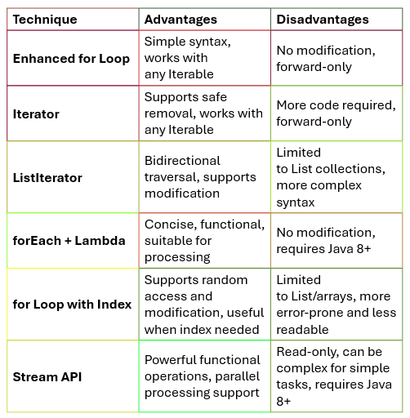
Advantages and Disadvantages of different Traversal Techniques

Slide 23


